Slide 1
Analyzing São Paulo data and open a new restaurant in the city
Rodrigo Mendrico
01/2021

Slide 2
Introdution
➔ The idea is to help a new investment company to discover where is the best place and the best type of restaurant to open in the city of Sao Paulo,Brazil.
➔ I will use the foursquare to check how other restaurants are graded and how they are distibuted among the Sao Paulo city´s neighborhood among with other data from city´s oficial site. I will will check for opportunities identifying the type of restaurants and where are the best neighborhoods to apply.

Slide 3
Data
➔ Foursquare to check how other restaurants are graded and how they are distibuted among the Sao Paulo city´s neighborhood.
Economic and Educational data from Sao Paulo City official site https://www.prefeitura.sp.gov.br/.
➔ Geopy coordinates to plot maps

Slide 4
Methodology
Use clustering k-means that is a unsupervised machine learning algorithm.
Data source with unlabeled data
Make easy to analyze data distribution
We grouped restaurant by type and therefore we check where is the region with less restaurants in that type. We considered the 3rd type that is a type or restaurant with less concurrency and that is already implemented in that area successfully

Slide 5
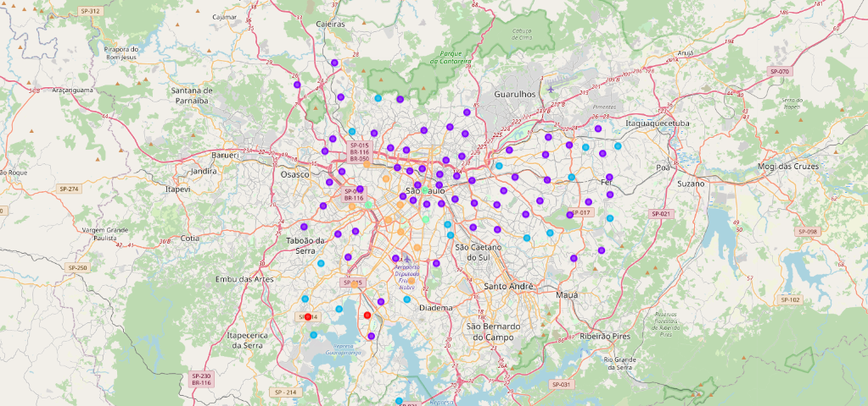
Analyzing income
We were able to identify the regions where the population has the larger income

Slide 6
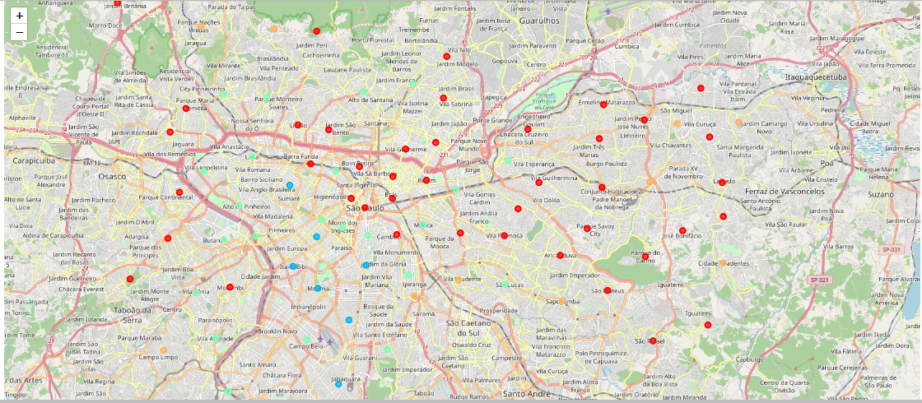
Education Data Clustering
We were able to identify the regions with higher education

Slide 7
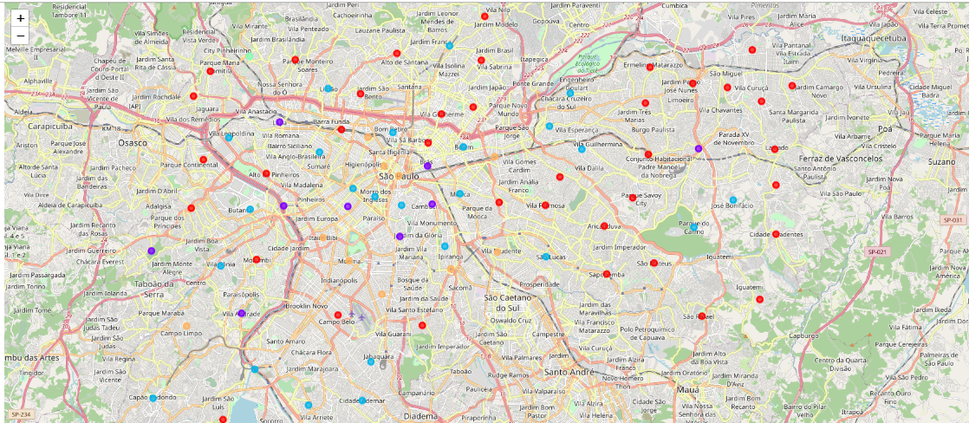
Houses Building Cluster
We were able to identify the regions with more investment. Besides the regions with more new houses will have more demand for customers.

Slide 8
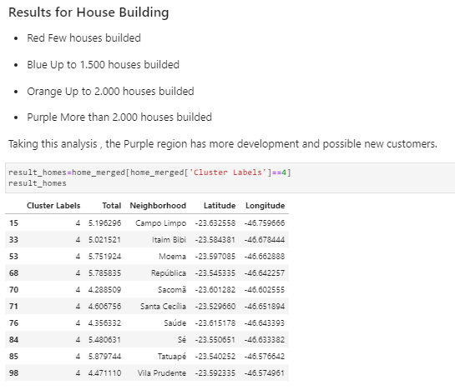
Results

Slide 9
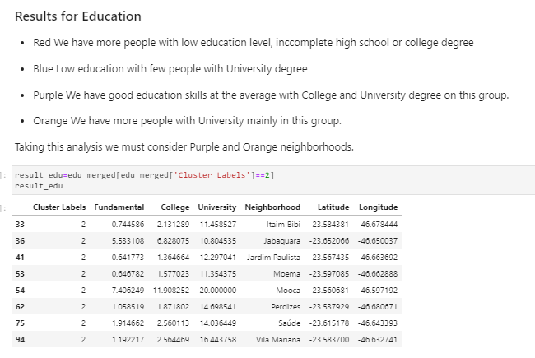
Results

Slide 10
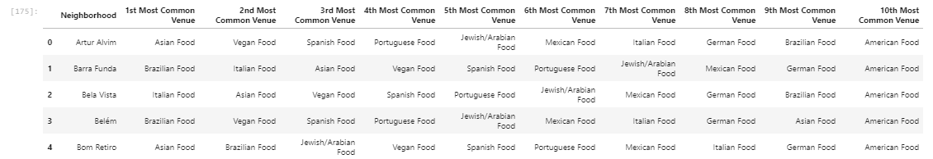
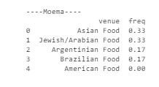
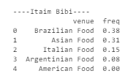
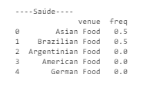
Results
Results for the type of restaurants according Moema, Itaim Bibi and Saude Neighborhood

Slide 11
Conclusion
We analyzed the following data:
Foursquare data for categories in each neighborhood
Income data
New houses building
Using this methodology, we can conclude therefore that we could open a new Italian Restaurant on Itaim Bibi, a new Vegan restaurant on Saude or a new Brazilian restaurant on Moema neighborhood.¶

